Slide 1
Strategic Volunteer Engagement: Recruiting in a Time of Crisis
Dr. Megan Conway
President and CEO
Volunteer Canada

Slide 2
Territory Acknowledgement
At Volunteer Canada, we recognize and acknowledge the Indigenous Peoples as the original stewards of the lands on which we live, work and volunteer. We humbly express our gratitude for their longstanding presence and enduring connections to this land.
Reconnaissance des territoires
Bénévoles Canada reconnaît les peuples autochtones comme les premiers intendants des terres sur lesquelles nous habitons, travaillons et faisons du bénévolat. Nous tenons humblement à exprimer notre gratitude pour leur présence de longue date sur ces terres et les liens durables qu’ils entretiennent avec elles.

Slide 3
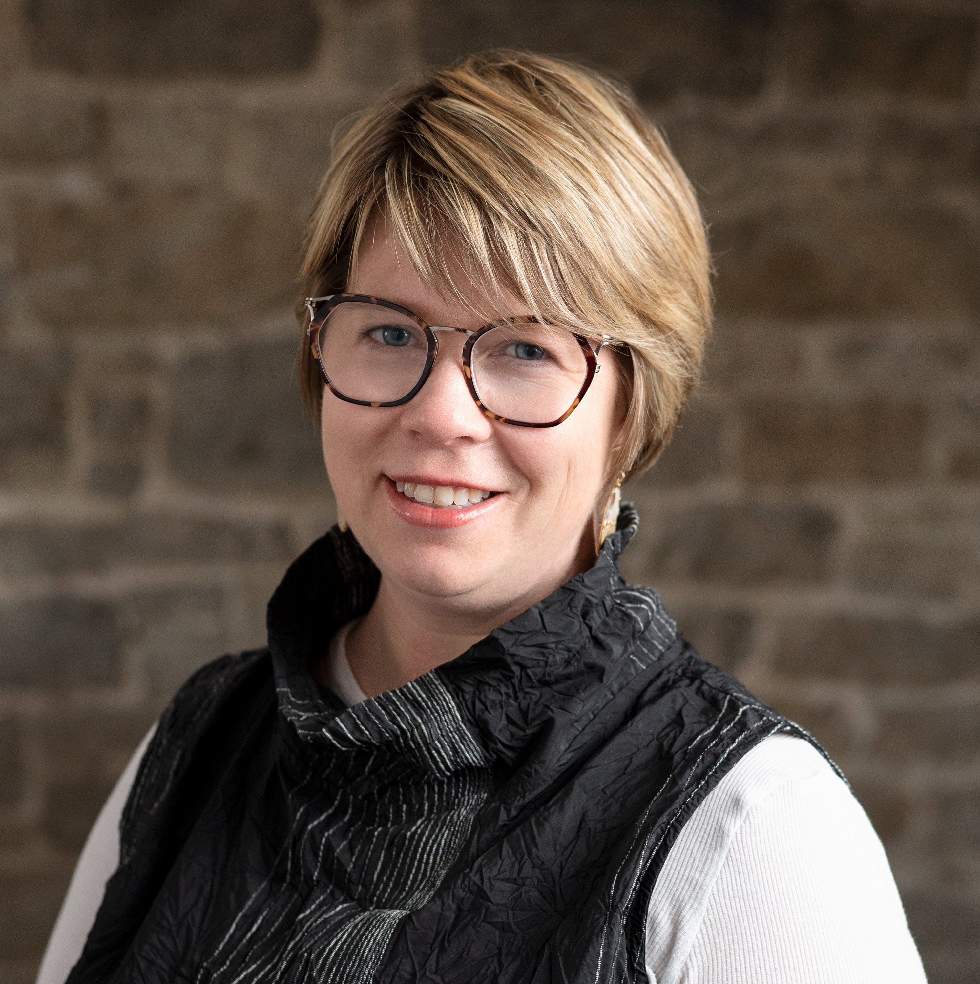
Dr. Megan Conway
President and CEO
Volunteer Canada

Slide 4

Vision – The value of one, the power of many.
Mission – We advance volunteerism to grow connection, community, and belonging.
Convening, connecting, and collaborating since 1977 with all sectors to encourage and support volunteerism and meaningful community engagement.
Volunteer.ca

Slide 5
Today’s Discussion
Pulse-taking Crisis and Current State Vs Future State
Significance of Strategic Volunteer Engagement
Standards and Stages of Volunteer Engagement
Volunteer retention and brand ambassadorship

Slide 6
Pulse-taking: Urgency
Current State of Volunteer Engagement
  Describe the state of volunteering in your organization in a newspaper headline today
  Describe the state of volunteering in five years from now

Slide 7
Discussion
Who from the following 4 profiles is volunteering?
Jane, for the past 10 years, has been volunteering with the local food bank 6 hours a week, helping with inventory and packaging with no expectation of compensation or reward.
Julie, is a Board Director of a local youth development centre serving a 4-year term. The primary objective of volunteering is to gain leadership skills.
Jason is volunteering at the local music festival, fulfilling a court mandate to do 10 hrs of community service work instead of a sentence due to a non-violent traffic violation.
John is a post-secondary student in a Community Development diploma program and is volunteering at the local community centre to earn practicum credits as partial fulfilment course requirements.
Notes:
This exercise, which debates on the definition of a “volunteer” and distinguishing it from the definition of “volunteering”, is to set the stage for the value of investing in strategic volunteer engagement.
Jane and Julie: Are volunteers. While Jane’s objectives are purely altruistic, Julie’s objectives are professional development focused. Yet, they both contribute their time, effort and skills with free will. They are both volunteers and they are both volunteering.
Jason: There can be an argument in favour of free will since Jason has the option to serve his sentence instead of community service work. However, the option of serving a sentence is on the extreme end of the spectrum. His free will is in a way forced. Whatever Jason’s options are, he is still volunteering.
John: Is not a volunteer since he is receiving educational credits. However, John is volunteering.

Slide 8
Volunteering?
U.N. Definition of Volunteering
The terms volunteering, volunteerism and voluntary activities is understood to be “a wide range of activities undertaken of free will, for the general public good, for which monetary reward is not the principal motivating factor.” (A/RES/56/38)
Notes:
“for which monetary reward is not the principal motivating factor.”: This implies that monetary reward can be offered to a volunteer such as an honourarium. When offering honourariums, be guided by CRA defenitions and standards.
Everyone who volunteers with your organization or group, irrespective of their objectives of volunteering, must apply due diligence with the duty and standard of care for a safe, secure, supportive, and meaningful volunteer experience. Therefore, the organization or group must have a strategy for volunteer engagement.

Slide 9
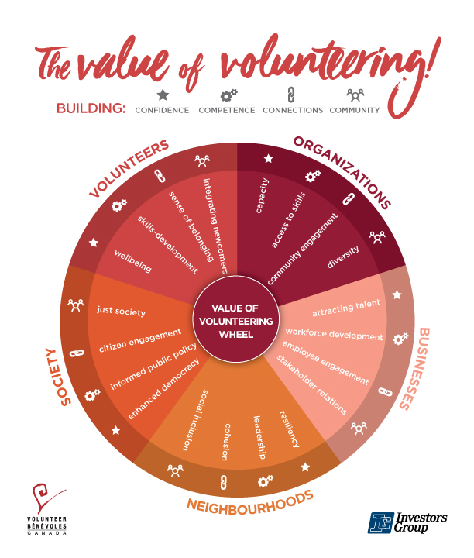
Notes:
Not-for-profit organizations can use the Value of Volunteering Wheel to organize their thoughts and message as they build a case for volunteer engagement.

Slide 10
Reflection
Is volunteer engagement
a program or a function?
Notes:
Volunteer engagement is not a program. It is an organizational function just as HR. The 2 departments may reside under the HR Banner or as 2 stand-alone departments.
Many factors have contributed to misinterpreting what volunteer engagement is. Such as reframing it to fit funding parameters and simply continuing to call it a program, which is then incorrectly picked up by future generations of leaders of volunteers. There can be volunteer-led programs within an organization. However, ‘volunteer engagement’ is a function.
In the next slide, it emphasises that, if ‘volunteer engagement’ is a function, then it requires a strategic approach to managing the function.

Slide 11
Volunteer Engagement is an Operational Function,
Not a Program
Canadian Code for Volunteer Involvement (CCVI; The Code)
An Operational Function requires a strategy.
Mission-based
Risk Management
Human Resources
Screening
Infrastructure
Training and Orientation
Evaluation
Support and Supervision
Volunteer Roles and Recruitment
Recognition
Notes:
First, indicate the types of standards that should be in a functional department (which works with people) strategy. Then the slide will transition to share that the CCVI is developed to introduce these standards.
CCVI is currently in its review phase.
Standards: The CCVI is a guide to help organizations develop policies and standards of their own.
Application Framework: Following standards is to apply a volunteer engagement cycle to develop the practice and procedures.
Practice: Screening is carried out when engaging volunteers.

Slide 12
Volunteer Engagement is an Operational Function,
Not a Program
Canadian Code for Volunteer Involvement (CCVI; The Code)
Adopt The Code
Prepare - Declare – Inspire
Prepare the organization, and assess using the Code Audit tool
Board signs off, declares and encourages organization-wide adoption
Maintain standards and inspire other organizations

Slide 13
Reflections (Current Practice)
Where do you currently recruit your volunteers from?
What is your current volunteer retention strategy?

Slide 14
Strategic Volunteer Engagement
Strategy
Make it a strategic effort for maximum impact (needs, role design, organizational strategy)
Periodically Review (the strategy, policies, needs)
Plan
Recognition fosters retention and emotional connection (celebrate, nominate, commemorate)
Strategic Outreach and Storytelling (share the impact, meet the target audience, identify the most effective marketing channel)
Recognize
Outreach
Retention is the result of a collection of moments.
Training and Supervision (a supportive environment fosters retention and commitment)
Support
Engage
Recruitment and role assignment
(an organized effort – a formal process - builds credibility and drives impact)
Evaluate
Measure what matters;
is also risk management
Notes:
For Recruitment Focused programs: Focus on Plan, Outreach, Engage.
Attn Megan: Script of a webinar for context:
To help us with the steps you can take, I am going to use this simplified version of the Volunteer Engagement Cycle – with the stages titled plan, engage, support, recognize, and evaluate at each stage.
First, all Leaders of Volunteers should refer to volunteer engagement as a function and not as a program – it is an operational function and not a program - just as you would treat Human Resources as a function. So, volunteer engagement then needs to be looked at as an organizational function that supports mission delivery, and to do so, it needs a clear organizational strategy. In short, let’s call it strategic volunteer engagement.
When we look at the declining numbers of volunteers, we also have to be careful of how we look at those numbers. For example;
Lack of consistent flow of volunteers: will not always mean that there are no volunteers as mentioned before. It could mean that volunteers are looking for DIFFERENT ways of participating. Such as virtual, remote, episodic, and micro-volunteering. Or, the fact that volunteers’ lifestyles are changing; such as people seeking hobbies and recreation that keep them occupied and socially active. Or, inflation has changed the economic circumstances, sometimes increasing the cost of volunteering more than it once did.
Difficulty recruiting new volunteers: could be that organizations may not be reaching the right audience with their volunteer recruitment effort – not going to the right place to look for volunteers.
Have we fully realized the impact of family and intergenerational volunteer engagement? Engaging parents, grandparents, and children today will inculcate the value of volunteerism in the children who will be adults in years to come.
Organizational Introspection: Is the volunteer having a memorable experience? So that, they become brand ambassadors and refer others or even become potential donors. Is the experience you provide the volunteers driving word-of-mouth advertising?
So, to come back to making this a strategic effort – I am confident you will agree that Volunteers build your capacity, and they come with a wealth of expertise, experience and fresh perspectives. My message to any party who is involving volunteers is to strategize and invest in volunteer management. Until 2022, for over a decade I was with a volunteer centre. In my role I worked very closely with the community service organizations and volunteers. Most often, when I hear that an organization is struggling with volunteer retention, what I find as the root cause is the lack of an organization-wide effort in supporting volunteer engagement. Volunteering is either a secondary topic, championed only by a single person, hardly represented at the strategic table or all of the above.
Strategic volunteer engagement is…..
to plan, declare the plan and execute the plan, which will also identify how outreach and recruitment are going to be handled - taking the current trends in volunteerism into consideration.
To identify the volunteer’s journey with your organization and their role and to provide a safe and supportive experience.
To follow all the way through to recognizing the volunteer contributions.
And ensuring that you develop the required policies - and measure what matters with your evaluations.
The important thing to realize here is that recruitment, engagement and retention is a result of an accumulation of
volunteer engagement activities,
volunteers’ experiences,
and their interpretation of how well-prepared you are to engage them.
Volunteer recognition alone does not guarantee retention. Think of it as a volunteer experience chain and the chain is as strong as its weakest link.
You can have a brilliant strategy,
an attractive outreach effort,
and a grand celebration,
but for example, if the recruitment process is cumbersome with outdated policies and technology
and/or only the volunteer manager is championing the volunteers, - the volunteers soon begin to question the value of giving their time to the organization instead of giving time to their family and friends or to another organization.
This is also to say that investing in volunteer management is just as important as having a strategy.
Hire a qualified Leader of Volunteers if possible or appoint a dedicated person to coordinate the organization-wide effort.
Then follow through to supporting this person with professional development. This is also an important aspect that I have seen community organizations overlook either because of lack of funding or, again, because there is no proper volunteer engagement strategy that prioritizes taking care of their leader of volunteers. Look for ways to include professional development plans in a funding application. For example, if the program applying for is about engaging older adults or even youth as volunteers, see if the proposal has the freedom to include learning related to intergenerational volunteer engagement.
The value of a Leader of Volunteers is that they can champion not only the volunteers but, with the necessary support, champion the volunteer engagement strategy that will ultimately build capacity for mission delivery.
The value of investing in volunteer management is that it paves the way for strategic foresight in volunteer engagement.
Lets take a look at these stages of the cycle.
During the planning stage, consider the current trends in volunteerism and see if your roles need to be re-designed. The trends show a preference to remote, virtual, episodic or micro-volunteering. Should you consider these preferences and re-design roles.
----
Once you have your plan, during the engagement stage, this is when the outreach, recruitment and role assignment happens.
How are you advertising, who’s support are you seeking,
- are you partnering with your local volunteer centre?
- have you considered engaging your local business to engage their staff in corporate volunteering?
- are you reaching out to your local social service clubs such as the Lions Clubs, Rotary Clubs and similar groups?
- are you reaching out to your local sports teams who may be looking for group volunteering experiences? And, when it comes to group volunteering experiences, are you ready, if yes, that is great and is that plan consistent. If you do not engage groups, why not?
For recruitment,
- are your volunteer recruitment processes streamlined making it easy for the prospect to volunteer? Through the data on barriers to volunteering, a top challenge reported by volunteers is that it is not easy to volunteer where the processes are concerned.
- are you leveraging technology to reach a wider audience? If so, is it accessible, is it easy to use, and does it make your lives easier rather than you having to work for the technology?
During role assignments;
- are you clearly, and in an organized way, conveying the expectations of the role?
- do they have the right tools?
- is the entire organization supportive of their experience?
- are you creating a memorable experience for the volunteer?
- In short, are they starting on the right note, and are they supported?
You will see a theme in my message that Volunteer Retention is a collection of moments in a volunteers’ journey with you.
Every Moment Matters.
-----
This journey is at its most crucial stage when volunteers are serving in their roles. That takes us to the ‘support’ stage.
This is when volunteers usually move from…
- being excited to work with you…
- through to assessing their impact and deciding their continuation with the role or the organization.
The “Support” stage is about the organization providing a safe, secure and supportive environment for the volunteers.
During this stage, relationship-building matters the most. If I am to elaborate;
The orientation and training provided to the volunteer will help them start on the right note.
Supervisor's meet and greet moment and the ongoing relationship with the volunteer is crucial for the volunteer to feel welcomed and supported.
Checking in on the volunteer, engaging in conversation, and keeping lines of communication open build camaraderie.
Volunteers tend to see things from a fresh pair of eyes, and they see innovative solutions sometimes. So, encouraging feedback and ideas, and assessing the potential of their idea ‘with them’ - shows that you care about their contributions.
Flexibility in shifts and schedules shows them that they are a valuable addition to the organization.
Highlighting the impact of their contribution shows them that you pay attention. It is a morale boost.
All of these leadership qualities will gradually strengthen the volunteer’s emotional connection to the organization.
----
I did state that recognition alone does not guarantee retention. Yet, ensuring recognition is imperative in the volunteer engagement strategy.
When it comes to volunteer recognition, my recommendation is to make it a 12-month plan rather than just a one-time activity.
What I am eluding to here are 3 simple forms of recognition.
Celebrate
Commemorate
Nominate
Celebrate their contribution and impact on a one-to-one basis, - and praise as when an exemplary deed is observed. Of course, praise in public only if the volunteer is comfortable with public praise.
Leverage commemorative days such as the National Volunteer Week in April by Volunteer Canada, International Volunteer Managers Day on November 5, and International Volunteer Day on December 5, and 2026 is the International Year of the Volunteer. Leverage those days for storytelling and gathering when possible.
Nominate the volunteers for your internal awards - and the local, provincial, and national awards programs.
Support your leader of volunteers in co-developing a 12-month plan with the rest of the organization and help the person with its execution.
The most important aspect is considering how the volunteers prefer to be recognized. I am a member of Lions Club International. In my home club, we have a remarkable member who is a senior and every day of the week she volunteers in various organizations. We wanted to recognize her by donating to the local hospital and dedicating a Patient Ward named after her. She said no. She did not want that kind of public recognition. Instead, what she appreciated the most was the President speaking to her on a one-to-one basis and showing how many lives she has touched through her contributions. That keeps her going.
Finally, evaluate at each stage.
But, measure what matters. The quality of service matters just as much as the number of clients reached.
And have a strategy review period. Volunteer trends change with the socio-economic trends. Have a clear periodic review period.
What I shared through this slide is by no means a Volunteer Management 101. Each stage has its own learning curve. However, I encourage you to use the information you receive today and start conversations to bring volunteer engagement to the strategic table.

Slide 15
Plan
Needs Analysis
Strategic volunteer engagement towards mission delivery.
Position Design
There is a distinction between;
Position Design
Position Description
Position Advertisement
Risk Assessment
Who… is the client?
is the volunteer?
is in a position to harm the organization
What… is the activity?
is the nature of the relationship?
Where… is the activity taking place?
is it isolated? Any inherent danger?
How often… does the supervisor oversee the activity?
do others access the relationship?
Notes:
Important to emphasize this slide. This is where all recruitment strategies should start.
- Position Design: is about designing the role including carrying out risk assessments
- Position Description: is about defining the role in a descriptive manner. Inexperienced leaders of volunteers incorrectly start with writing a position description.
- Position Advertisement: is the not the same as the position description. It is an advertisement that should follow the principles of marketing and storytelling.

Slide 16
Outreach
Have You Considered? What are success stories? Any challenges?
Volunteer Centres
Youth Groups
Academic institution and/or programs
Social Service Clubs
Local sports groups (clubs and schools)
Local businesses
Big businesses with social responsibility programs
Newcomer and employment services
Faith-based groups/organizations
Social media takeover days (all stakeholders posting on the same date and time)

Slide 17




Engage and Support
Whole person Approach
Head
Expectations, knowledge, information
Hands
Processes, tools, resources, work conditions
Spirit
Heart
Guidance, support, leadership
Notes:
Adopted from: The Whole Person Approach by Dr. Stephen Covey. Take care of the whole person for the person to have a meaningful experience.

Slide 18
Strategic Volunteer Engagement
Strategy
Volunteer retention is the accumulation of positive experiences throughout the volunteers’ journey with the organization/group.
#EveryMomentMatters
Volunteer retention is not confined to a single activity such as recognition.
It is like a service delivery chain; the chain is as strong as its weakest link.
Make it a strategic effort for maximum impact (needs, role design, organizational strategy)
Plan
Strategic Outreach and Storytelling (share the impact, meet the target audience, identify the most effective marketing channel)
Recognize
Outreach
Retention is the result of a collection of moments.
Support
Engage
Recruitment and role assignment
(an organized effort builds credibility and drives impact)
Evaluate

Slide 19
Practical Steps for Volunteer Management
Strategic Focus: Refine and adapt the volunteer engagement strategy
Data-driven Engagement: data-informed and evidence-based decision-making
Foster collective impact: Partner, collaborate, share
Invest in Volunteer Management: Professional development, tools
Design meaningful volunteer experiences: Review and re-design
Connect with expertise: Volunteer Canada and Volunteer Centres
Leverage technology: It does not always mean an expensive investment
Notes:
In summary, the practical steps that I mentioned today are…..

Slide 20
Resources
Volunteer Canada: www.volunteer.ca
National Volunteer Action Strategy: www.volunteerstrategy.ca
Canadian Knowledge Hub for Giving and Volunteering: www.givingandvolunteering.ca
List of Volunteer Centres Across Canada: https://volunteer.ca/Listings.php?ListType=VC_List_Public&MenuItemID=385
Value of Volunteering: https://volunteer.ca/index.php?MenuItemID=383
Data Management for Creating Impactful Volunteer Programs [Article]: https://www.vmpc.ca/cgi/page.cgi/member_blog.html
Notes:
You can find the resources I referenced in this slide.

Slide 21









Stay in Touch​ | Gardons contact!
Visit our website: volunteer.ca
Contact us: info@volunteer.ca
Site Web : volunteer.ca​
Courriel : info@volunteer.ca
Subscribe to Volunteer Vibe​​ /
Abonnez-vous à Parlons bénévolat :​
blog.volunteer.ca ​
Become a Member​​ / Devenez membre :​
volunteer.ca/membership
Follow us on Social Media
@VolunteerCanada​
Suivez-nous dans les médias sociaux
@BenevolesCanada​
Notes:
If you haven’t yet reaped the benefits of Volunteer Canada Membership, please check out the membership details and benefits at volunteer.ca/membership.
And with that, that is my time today.
Thank you everyone! I will be happy to take any questions.

