Slide 1

5 Governance HaCks
Meeting the Moment
Volunteer Leadership Symposium
Kings Volunteer Resource Centre
May 15, 2024
Notes:
LAND ACKNOWLEDGEMENT
Light Bulb

Slide 2
The Five Hacks
Board calendar
A “friendly” chair check-In
Your own “Rules of Order”
Invite guests to your board room
Do not ask “are there any questions”?
Notes:
What is meant by a “hack” these days?

Slide 3

Hack 1: Board Calendar
Annual board work and meeting plan
Schedule of the main governance matters the board should address over the year ahead
Schedule of governance matters the board wants to address over the year ahead
Calendar need not include routine board agenda items (e.g. approval of minutes)
May include both board and committee meetings
May include special events where board member presence and/or participation is expected
Notes:
Handout
18 months is better
Not a list of dates
What do I mean by routine items?

Slide 4

Board calendar: should include
Evaluation of the executive director
Board recruitment (directors and officers)
Scheduling and organization of AGM
Approval of the annual budget
Quarterly financial report
Discussion of specific strategic goals
Review of at least one board-focused policy
Review of one operational policy
Notes:
WHAT ELSE?
How many meetings for each – some twice a year?
Board Room Guest
How much time

Slide 5
APRIL Monday, April 22 AGM Planning | MAY Monday, May 20 REVIEW GOAL #2 | JUNE ANNUAL GENERAL MEETING | JULY NO BOARD MEETING
AUGUST BOARD-STAFF BBQ | SEPTEMBER REVIEW GOAL #3 | OCTOBER REVIEW POLICIES X & Y | NOVEMBER
DECEMBER QUARTERLY FINANCIAL REPORT | JANUARY ED EVALUATION RECRUITMENT | FEBRUARY GUEST SPEAKER | MARCH BUDGET APPROVAL

Slide 6
Board Calendar: might include
Review of the bylaws
Creation of a new board-focused policy
Creation of a new operational policy
A plan to embark of a new strategic plan
  What, when, how & who
  Establishment of a committee
Board self-evaluation
Board education session
Guest presentation
Notes:
Examples from the group for each new policy

Slide 7

Board Calendar = Board Agenda
Calendar plan ought to drive board meeting agendas
Main users: Chair and ED
Notes:
What do you see as the DOWNSIDE?
ONGOING ADJUSTMENT
Rather than a standard agenda
Agenda differs from meeting to meeting
CHECK TIME

Slide 8
Hack 2. A Friendly “Chair Check-in”
Thirty-minute board room exercise
Agenda “other business”
A bit of a board self-evaluation
Goal
  Offers a clearer board mandate to the chair
  Encourages board reflection
New board chair and seasoned board chairs
ED should participate
Notes:
As much about the Board as about the chair
Who here are board chairs?
Asking for feedback need not be scary
New chairs or experienced chairs
Not every chair will want to

Slide 9
Board chair “check in” questions
Given where we are as an organization, what do we, need to focus on more in our board meetings?
Are there things that we could probably focus less on?
Are there things I do well in managing our board meetings?
Are there some things I could change in managing our board meetings?
Notes:
Suggested questions
What questions, would you ask?
How are we doing as a board?

Slide 10

Exercise steps
Read out or distribute a sheet with the questions (2)
Provide paper and pencil
Allow the 5 -8 minutes of quiet time
Hear from each person without comments (go around)
Ask for additions or other comments
Chair’s response
Commitment make some changes
Notes:
When would you not use this hack?

Slide 11
Hack 3. Board Meeting Rules
Do We Need a Motion for That?
What organizational matters ought to be marked by a formal, and minuted, board decision?
  Motion, seconder & vote
  Test for consensus
Notes:
Do we need a motion for that?
Not about voting.
Roberts Rules
Legally important
Dissention????
ASK FOR EXAMPLES

Slide 12
Key formal board decisions?
Approval of the budget or revised budget
Approval of a new or revised policy
Acceptance of ED evaluation
Appointment of board officers
Approval of a new strategic plan
Approval of change in ED’s compensation
Approval of organizational-wide wage increase
Establishment of a reserve fund
Approval of expenditure from a reserve fund
Hiring or termination of the ED
Acceptance of a board resignation
Appointment of an acting board member
Approval of a loan, mortgage or expanded line of credit
Notes:
Approval of agenda?
What are things that should be formally decided and and recorded in the minutes?
Do you need to approve the ED Report, financial report (acceptance perhaps)
Forward looking

Slide 13
Other formal decision matters?
Letter to the Minister
Special thank you
Show of appreciation
Acceptance of a risk
Notes:
I have a template I can send
Show of hands vs verbal approval
Sample

Slide 14
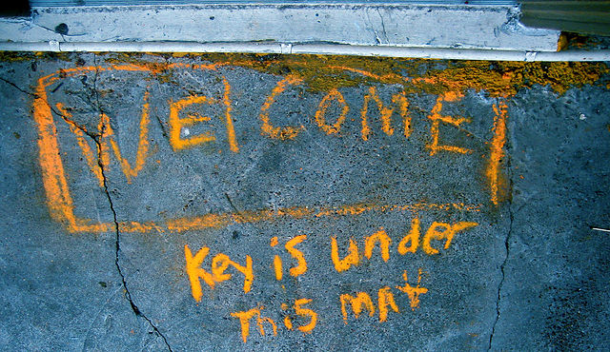
Notes:
Quote

Slide 15
Hack 4. Invite a guest to your boardroom
Cultivate a bigger picture
Look beyond your own organization
Think about the future
Make for a more interesting board meeting
Change the board routine
Make your organization more visible
Notes:
How many have invited outside guests to a board meeting?
Examples?
Why or why not
Not decision oriented

Slide 16

Guests in the board room
Who to invite?
Formal presentation?
Fee / gift
Invite staff
Notes:
Examples of outside guests you have attended your board meetings
Suggest someone
Volunteer to invite them
Put guest session in your calendar

Slide 17
5. Don’t ask “are there any questions?”
What sometimes happens when we invite questions?
How can we we do a better job asking the board for input or improving their understanding of more insightful questions?
Notes:
What can happen if we just ask? Good questions need not have good answers, or answers a t all.
Operational bent to questions

Slide 18
Some “better” questions
What worries/likes do board members have about where we are?
How does the committee's proposal reflect our organizational priorities?
Are there some bigger picture matters we should be considering here?
What are some less operational matters we need to focus on?
What concerns do you have that I have not reported on?
In what ways could I report this information in a more helpful way?
Do we have a policy on this matter, or do we need one?
What regular practices could we put in place to make this better?
What aspects of this initiative excites you?
What are the implications of this for staff?
Do we know how are other organizations doing this?
What are our organizational aspiration on this item?

Slide 19
The Five Hacks
Board Calendar
A “Friendly” Chair Check In
Your Own Rules of Order
Guests in the Board Room
Do Not Ask (Are there any questions?)
Notes:
Which of the five hacks will you try????
Hands up
When?

Slide 20
Thank you!

