Slide 1
FUNdamentals of FUNdraising:
Finding joy and success in fundraising
Jennifer Bolt
May, 2024

Slide 2

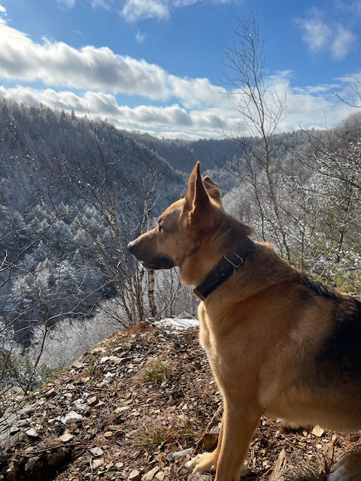


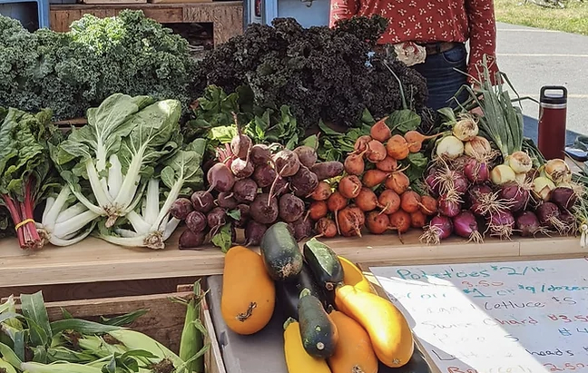
Getting to know you…..

Slide 3
Getting to know you…..
How important is fundraising to your organization? (1-10)
How many people in your organization have fundraising as part of their job?
How many “donors” contributed to your organization last year?
How does your organization raise funds?
What is a word you would use to describe your thoughts about fundraising?
How much do you look forward to fundraising? (1-10)
Could you name your top 10 donors? Could others in your organization?

Slide 4


Commonly observed
Fundraising capacity and needs are diverse
Lots of asking, especially locally
Fundraising is not easy; asking is hard
BUT…..
Fundraising enables mission
People like helping (and gambling!)
Generosity is contagious
Notes:
No such thing as rejection, or competition among charities. Simply finding those who align with our interests and will want an opportunity to help.

Slide 5
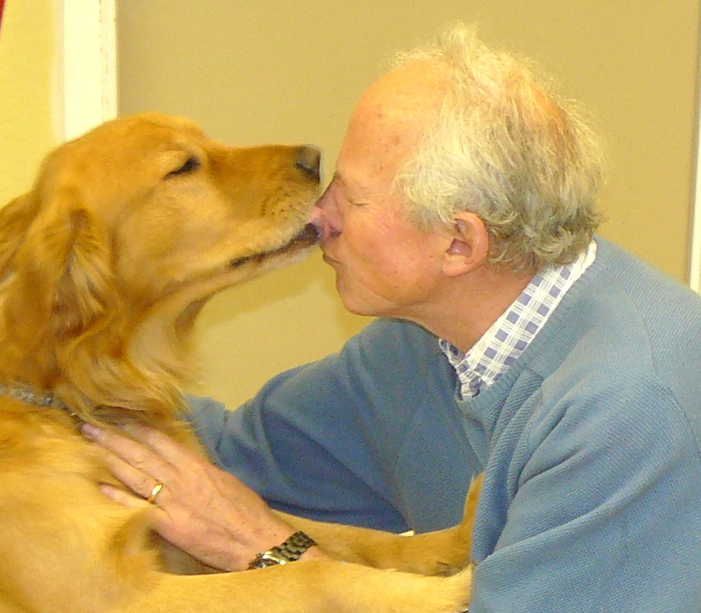
Fundraising redefined…
“Fundraising is proclaiming what we believe in such a way that we offer other people an opportunity to participate with us in our vision and mission.
It is the opposite of " begging. Rather, we are declaring, we have a vision that is amazing and exciting.”
Henri Nouwen
The Spirituality of Fundraising

Slide 6
Objectives of this session:
Change the way you think about fundraising
  Explore how fundraising activities connect
  Share some successful strategies
      Effective events
      Finding, cultivating prospective volunteers, event goers, and donors

Slide 7
Think of Fundraising as engagement:
DONOR
INTEREST
CHARITY
MISSION
PROSPECTS = LIA
Notes:
No such thing as rejection, or competition among charities. Simply finding those who align with our interests and will want an opportunity to help.

Slide 8
A Fundraising Program:
$
Legacy or Endowments
Events form a foundation for further fundraising
Major Gifts/Projects
Annual Fund
Events
Communications

Slide 9
Event Fundraising:
A good first step in relationship building!
PROS | CONS
Good for friend-raising | Not always good fundraising
Can attract new friends | Labour intensive
Increases profile | Attendance dependent
Can be organized by volunteers | Low returns

Slide 10
10 Measures of Successful Events:
People want to come!
Charitable mission is front and centre
Connects participants with those supported by the charity
Collects contact info of participants
Well-supported by inner circle
Makes volunteers feel successful and appreciated
Makes $
Results are tracked
Can be duplicated successfully
Planned further engagement
Notes:
Measure the success of your event by more than the dollars. Take a moment to rank an event.

Slide 11

Evaluated 15 annual events based on:
  Profit margin
  Reach (attendance)
  Public awareness
  Potential for profit/reach growth
  Human resource required
  Duration of planning required

Slide 12
Event Name | Actual Profit¹ | 1 | 2 | 3 | 4 | 5 | 6 | Total Event Score
Tag Days | $9,500 | 5 | 3 | 3 | 2 | 2 | 3 | 18
Golf Tournament | $8,000 | 5 | 3 | 3 | 3 | 1 | 1 | 16
Collection Boxes | $2,500 | 3 | 3 | 3 | 1 | 3 | 3 | 16
Weekend Auctions | $7,800 | 5 | 2 | 2 | 1 | 2 | 3 | 15
Calendars | $7,000 | 4 | 3 | 2 | 2 | 2 | 1 | 14
50-50 Draws | $2,800 | 3 | 3 | 2 | 2 | 1 | 2 | 13
Mall Days | $ 0 | 1 | 2 | 3 | 1 | 2 | 3 | 12
Craft and Bake Sale | $1,400 | 2 | 2 | 2 | 1 | 2 | 3 | 12
Walkathon | $3,300 | 3 | 1 | 2 | 3 | 1 | 1 | 11
Art Auction | $1,600 | 2 | 1 | 1 | 3 | 2 | 2 | 11
BBQ | $1,200 | 2 | 1 | 1 | 1 | 3 | 3 | 11
Yard Sale | $2,300 | 2 | 2 | 2 | 1 | 2 | 2 | 11
Rideathon | $1,000 | 2 | 1 | 1 | 2 | 2 | 2 | 10
Strawberry Social | $ 500 | 1 | 1 | 1 | 1 | 2 | 3 | 9
Kelsey’s Adoption Day | $ 0 | 1 | 1 | 1 | 1 | 2 | 2 | 8

Slide 13
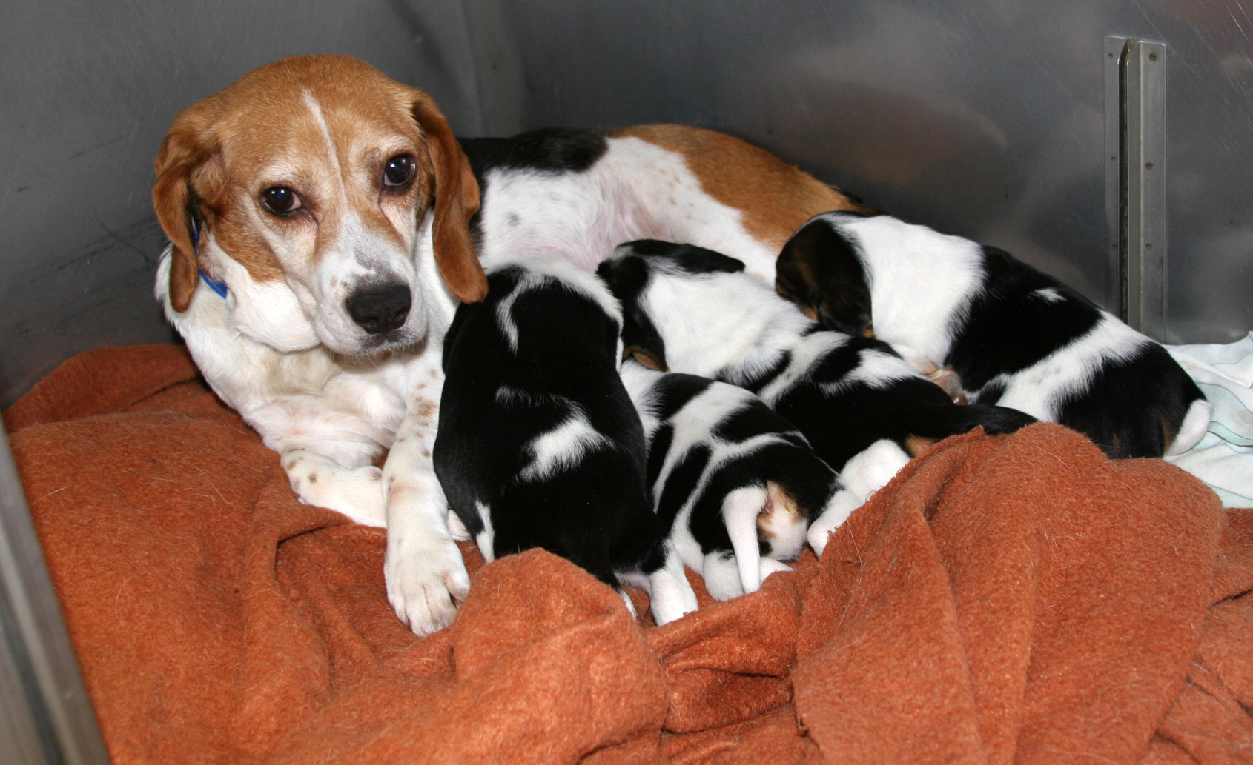
…and then a happy accident

Slide 14
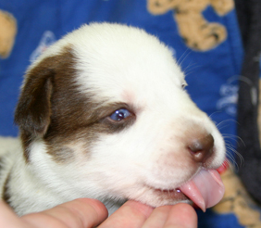
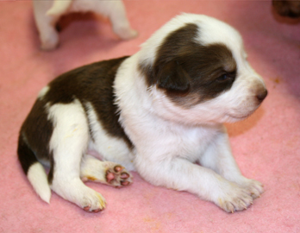
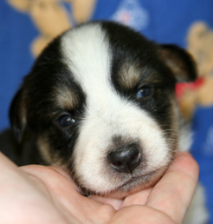
AGM Special Guests
Meet the puppies (at the AGM!)
Name the puppies
Help get the puppies ready for adoption
$10,000+ raised in one week!
Notes:
Good fundraising is opportunistic and allows people to experience the impact as closely as possible.

Slide 15

Growing Beyond Events:
Board member
First time event goer
Levels of Engagement

Slide 16
How to ask for support
“Ask for money, and you’ll get advice.
Ask for advice and you might get money.”
~ Unknown
  Share your hopes, dreams and needs
  Ask for feedback
  Share YOUR involvement
People who give are the people who care.
  Not necessarily people who you think have money!
Notes:
- hopes and dreams = strategic plans and tangible goals
- Case = funding you need NOW to accomplish your plan – layout the plan to get the funds
- Questions to ask: Does this seem important to you? Who might help us? Would you introduce me?
Make sure YOU are a donor (doesn’t matter how much)
- Avoid asking on the phone – leave people to think about it

Slide 17
10 Roles for Board Members
Speak about our positive work (privately or publicly)
Attend events
Introduce someone new to our organization
Make a donation (the amount is not important)
Volunteer on an event committee
Thank donors (volunteers, event attendees)
Understand our fundraising objectives, programs and impact donors have on our organization
Help recruit volunteers
Provide ideas of people or businesses that might sponsor or donate
Participate on team to ask others to give
Notes:
- hopes and dreams = strategic plans and tangible goals
- Case = funding you need NOW to accomplish your plan – layout the plan to get the funds
- Questions to ask: Does this seem important to you? Who might help us? Would you introduce me?
Make sure YOU are a donor (doesn’t matter how much)
- Avoid asking on the phone – leave people to think about it

Slide 18
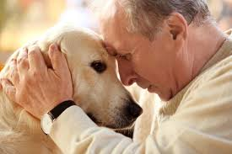
Remember why you do this….
At the end of the day, effective fundraising is nothing more than relationship building and inviting people to help when it is needed. If you believe in your cause, you are halfway there!

Slide 19
Please email me:
Jennifer Bolt - Jennifer.bolt@gmail.com

